Slide 2
U=U Getting the message across to the public
Ian Green
Terrence Higgins Trust

Slide 3
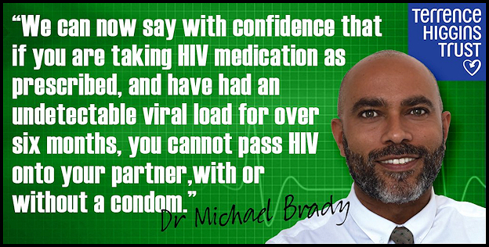

Slide 9
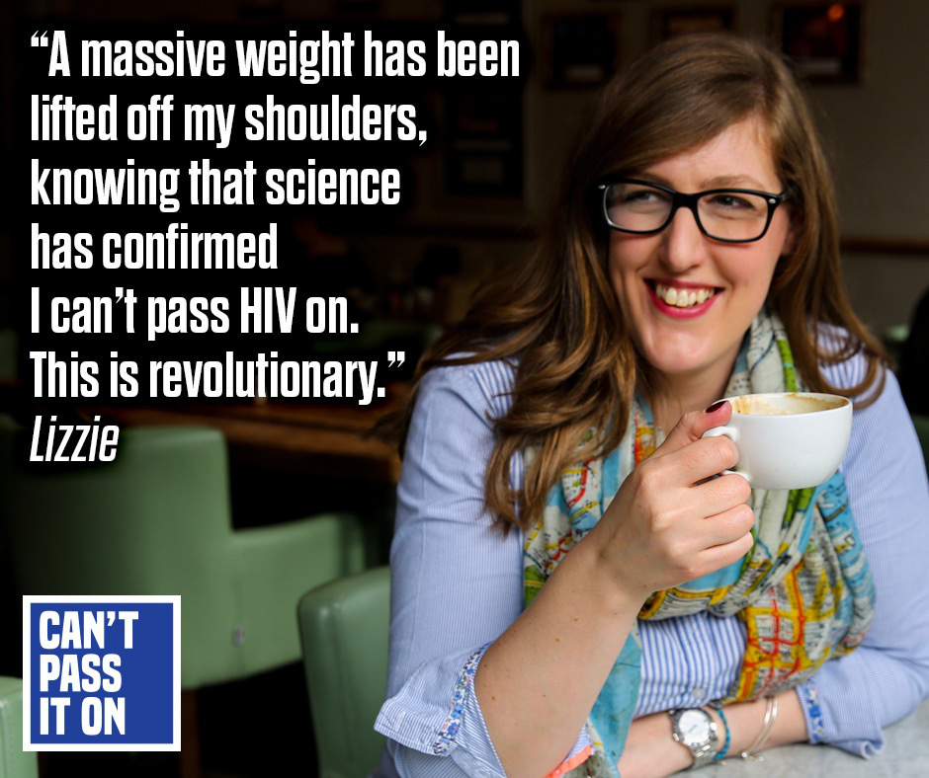

Slide 14
Questions to the Audience
1. How are you communicating the U=U message to the wider population and how effective has this been?
2. How do you engage with key population groups?

